Slide 1
Ethics in Information Technology, Third Edition
Chapter 6
Intellectual Property
Notes:
1

Slide 2
Trade Secrets
Trade secret
Business information
Represents something of economic value
Requires an effort or cost to develop
Some degree of uniqueness or novelty
Generally unknown to the public
Kept confidential
Information is only considered a trade secret if the company takes steps to protect it
Ethics in Information Technology, Fourth Edition
2
Notes:
2

Slide 3
Trade Secrets (cont’d.)
Trade secret law has a few key advantages over patents and copyrights
No time limitations
No need to file an application
Patents can be ruled invalid by courts
No filing or application fees
Law doesn’t prevent someone from using the same idea if it is developed independently
Trade secret law varies greatly from country to country
Ethics in Information Technology, Fourth Edition
3
Notes:
3

Slide 4
Trade Secret Laws
Uniform Trade Secrets Act (UTSA)
Established uniformity across the states in area of trade secret law
Computer hardware and software can qualify for trade secret protection
The Economic Espionage Act (EEA) of 1996
Penalties of up to $10 million and 15 years in prison for the theft of trade secrets
Ethics in Information Technology, Fourth Edition
4
Notes:
4

Slide 5
Employees and Trade Secrets
Employees are the greatest threat to trade secrets
Unauthorized use of an employer’s customer list
Customer list is not automatically considered a trade secret
Educate workers about the confidentiality of lists
Nondisclosure clauses in employee’s contract
Enforcement can be difficult
Confidentiality issues are reviewed at the exit interview
Ethics in Information Technology, Fourth Edition
5

Slide 6
Employees and Trade Secrets
Defining reasonable nondisclosure agreements can be difficult, as seen in the following example involving Apple.
In addition to filing hundreds of patents on iPhone technology, the firm put into place a restrictive nondisclosure agreement to provide an extra layer of protection.
Many iPhone developers complained bitterly about the tough restrictions, which prohibited them from talking about their coding work with anyone not on the project team and even prohibited them from talking about the restrictions themselves.
Eventually, Apple admitted that its nondisclosure terms were overly restrictive and loosened them for iPhone software that was already released
Ethics in Information Technology, Fourth Edition
6

Slide 7
Employees and Trade Secrets
For example, the Ohio State Supreme Court upheld a verdict against a man who left a financial services firm and recruited former clients to start his own firm. His former employer sued him, even though the former employee had not stolen a client list. “This ruling says, it doesn’t matter if the confidential list is on paper or in your memory if it qualifies as a trade secret
Ethics in Information Technology, Fourth Edition
7

Slide 8
Employees and Trade Secrets (cont’d.)
Noncompete agreements
Protect intellectual property from being used by competitors when key employees leave
Require employees not to work for competitors for a period of time
Wide range of treatment on noncompete agreements among the various states
Examples
Ethics in Information Technology, Fourth Edition
8
Notes:
8

Slide 9
Employees and Trade Secrets (cont’d.)
Noncompete agreements
The employee agrees as a condition of employment that in the event of termination for any reason, he or she will not engage in a similar or competitive business for a period of two years, nor will he or she contact or solicit any customer with whom Employer conducted business during his or her employment. This restrictive covenant shall be for a term of two years from termination, and shall encompass the geographic area within a 100-mile radius of Employer’s place of business.
Ethics in Information Technology, Fourth Edition
9
Notes:
9

Slide 10
Employees and Trade Secrets (cont’d.)
Noncompete agreements
IBM sued Mark Papermaster, a microchip expert, for violating a noncompete agreement when he announced that he intended to leave the company to join Apple as its head of device hardware engineering. The lawsuit was settled when Papermaster agreed to report to IBM should he suspect that any breakthroughs he develops at Apple infringe on proprietary or confidential information he learned while working at IBM. Papermaster must also twice submit to IBM a written declaration that states he is not using confidential IBM material in his role at Apple
Ethics in Information Technology, Fourth Edition
10
Notes:
10

Slide 11
Key Intellectual Property Issues
Issues that apply to intellectual property and information technology
Plagiarism
Reverse engineering
Open source code
Competitive intelligence
Trademark infringement
Cybersquatting
Ethics in Information Technology, Fourth Edition
11
Notes:
11

Slide 12
Plagiarism
Stealing someone’s ideas or words and passing them off as one’s own
Many students:
Do not understand what constitutes plagiarism
Believe that all electronic content is in the public domain
Plagiarism is also common outside academia
Plagiarism detection systems
Check submitted material against databases of electronic content
Ethics in Information Technology, Fourth Edition
12
Notes:
12

Slide 13
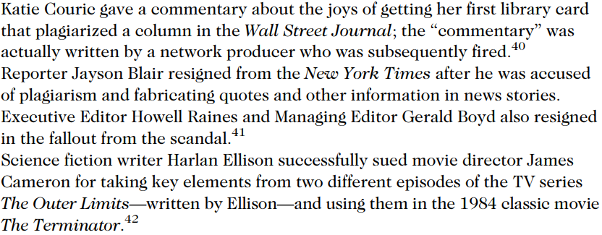
Plagiarism Examples
Ethics in Information Technology, Fourth Edition
13

Slide 14
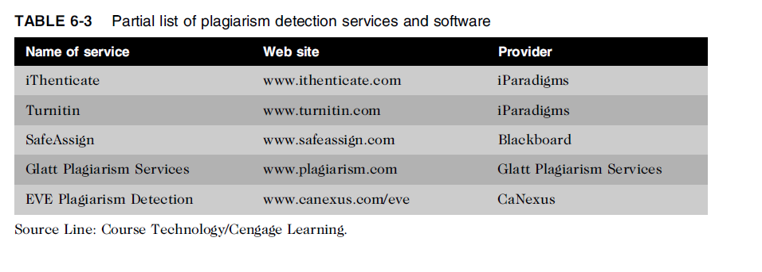
Plagiarism (cont’d.)
Ethics in Information Technology, Fourth Edition
14
Notes:
14

Slide 15
Plagiarism (cont’d.)
Steps to combat student plagiarism
Help students understand what constitutes plagiarism and why they need to cite sources
Show students how to document Web pages
Schedule major writing assignments in portions due over the course of the term
Tell students that instructors are aware of Internet paper mills and plagiarism detection services
Incorporate detection into an antiplagiarism program
Ethics in Information Technology, Fourth Edition
15
Notes:
15

Slide 16
Reverse Engineering
Process of taking something apart in order to:
Understand it
Build a copy of it
Improve it
Applied to computer:
Hardware
Software
Convert a program code to a higher-level design
Ethics in Information Technology, Fourth Edition
16
Notes:
16

Slide 17
Reverse Engineering
Convert an application that ran on one vendor’s database to run on another’s
Reverse engineering – Forward engineering
No issue doing this in-house
Unethical if done outside
Licensed, copyright, patent issues maybe raised
Not illegal if
Interoperability
Not protected
Ethics in Information Technology, Fourth Edition
17
Notes:
17

Slide 18
Reverse Engineering (cont’d.)
Compiler
Language translator
Converts computer program statements expressed in a source language to machine language
Software manufacturer
Provides software in machine language form
Decompiler
Reads machine language
Produces source code
Gain access to information copyrighted or trade secrete
Ethics in Information Technology, Fourth Edition
18
Notes:
18

Slide 19
Reverse Engineering (cont’d.)
Courts have ruled in favor of reverse engineering:
To enable interoperability
Example
Sega Enterprises Ltd. v. Accolade, Inc
An appeals court ultimately ruled that if someone lacks access to the unprotected elements of an original work and has a “legitimate reason” for gaining access to those elements, disassembly of a copyrighted work is considered to be a fair use under section 107 of the Copyright Act
To restrict manufacturer monopoly
Ethics in Information Technology, Fourth Edition
19
Notes:
19

Slide 20
Reverse Engineering (cont’d.)
Software license agreements forbid reverse engineering in USA
Ethics of using reverse engineering are debated
Fair use if it provides useful function/interoperability
Especially when documentation is not provided
Can uncover designs that someone else has developed at great cost and taken care to protect
Ethics in Information Technology, Fourth Edition
20
Notes:
20

Slide 21
Open Source Code
Program source code made available for use or modification:
As users or other developers see fit
Basic premise
Many programmers can help software improve
Can be adapted to meet new needs
Bugs rapidly identified and fixed
High reliability
Ethics in Information Technology, Fourth Edition
21
Notes:
21

Slide 22
Open Source Code
Reasons why source code is created
Some people share code to earn respect for solving a common problem in an elegant way.
Some people have used open source code that was developed by others and feel the need to pay back
A firm may be required to develop software as part of an agreement to address a client’s problem. If firm is paid for the employees’ time spent to develop software rather than for the software itself, it may decide to license the code as open source and use it either to promote firm’s expertise or as an incentive to attract other potential clients with similar problem
GNU General Public License (GPL) was a precursor to the Open Source Initiative (OSI)
Ethics in Information Technology, Fourth Edition
22
Notes:
22

Slide 23
Open Source Code
Reasons why source code is created
A firm may develop open source code in the hope of earning software maintenance fees if end users need changes in the future.
A firm may develop useful code but may be reluctant to license and market it, and so might donate the code to the general public.
Open source license
Bob Jacobsen vs Matthew A. Katzer case
Ethics in Information Technology, Fourth Edition
23
Notes:
23

Slide 24
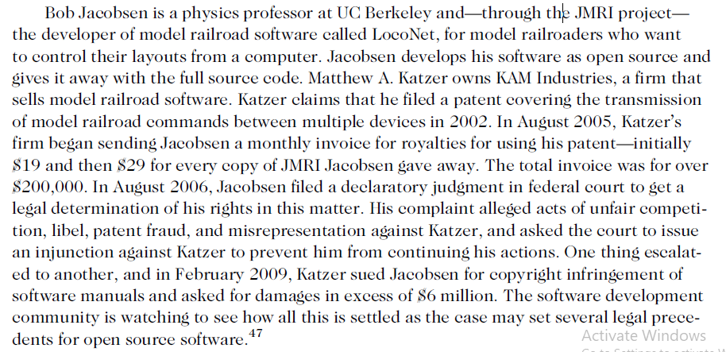
Open Source Code
Ethics in Information Technology, Fourth Edition
24
Notes:
24

Slide 25
Competitive Intelligence
Gathering of legally obtainable information
To help a company gain an advantage over rivals
Often integrated into a company’s strategic plans and decision making
Not the same as industrial espionage, which uses illegal means to obtain business information not available to the general public
Without proper management safeguards, it can cross over to industrial espionage
Dirty tricks ?
Ethics in Information Technology, Fourth Edition
25
Notes:
25

Slide 26
Competitive Intelligence
Without proper management safeguards, it can cross over to industrial espionage
One frequent trick is to enter a bar near a competitor’s plant or headquarters, strike up a conversation, and ply people for information after their inhibitions have been weakened by alcohol
Competitive intelligence analysts must avoid unethical or illegal actions, such as lying, misrepresentation, theft, bribery, or eavesdropping with illegal devices
P&G vs Uniliver case – page 218
Ethics in Information Technology, Fourth Edition
26
Notes:
26

Slide 27
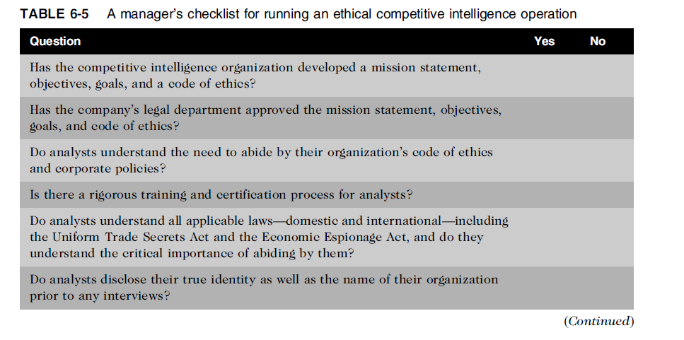
Competitive Intelligence (cont’d.)
Ethics in Information Technology, Fourth Edition
27
Notes:
27

Slide 28
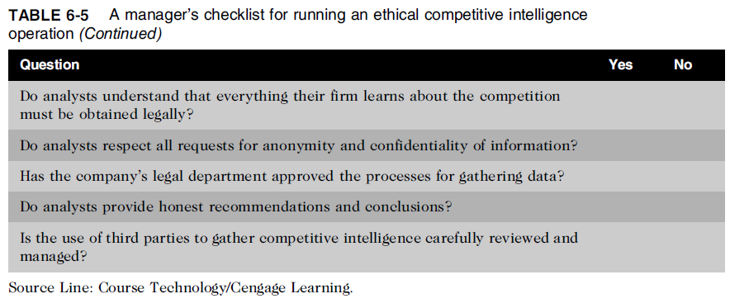
Competitive Intelligence (cont’d.)
Ethics in Information Technology, Fourth Edition
28
Notes:
28

Slide 29
Trademark Infringement
Trademark is logo, package design, phrase, sound, or word that enables consumer to differentiate one company’s product from another’s
Trademark owner can prevent others from using the same mark or a confusingly similar mark on a product’s label
Organizations frequently sue one another over the use of a trademark in a Web site or domain name
Nominative fair use is defense often employed by defendant in trademark infringement case
Ethics in Information Technology, Fourth Edition
29

Slide 30
Cybersquatting
Cybersquatters
Register domain names for famous trademarks or company names
Hope the trademark’s owner will buy the domain name for a large sum of money
To curb cybersquatting, register all possible domain names
.org, .com, .info
Ethics in Information Technology, Fourth Edition
30
Notes:
30

Slide 31
Cybersquatting (cont’d.)
Internet Corporation for Assigned Names and Numbers (ICANN)
Several top-level domains (.com, .edu, edu., .gov, .int, .mil, .net, .org, aero, .biz, .coop, .info, .museum, .name, .pro, .asis, .cat, .mobi, .tel, and .travel)
Current trademark holders are given time to assert their rights in the new top-level domains before registrations are opened to the general public
Anticybersquatting Consumer Protection Act allows trademark owners to challenge foreign cybersquatters
Ethics in Information Technology, Fourth Edition
31
Notes:
31

Slide 32
Cybersquatting (cont’d.)
OnlineNIC was one of the very first domain registrars licensed by ICANN. During 2008, Verizon Communications, Microsoft, and Yahoo! each filed separate lawsuits against OnlineNIC because that firm registered hundreds of domain names identical or similar to their trademark names (e.g., verizon-cellular.com, encarta.com, and yahoozone.com). In December 2008, Verizon was awarded damages of $31.15 million. OnlineNIC was prohibited from registering any additional names containingVerizon trademarks, and it was ordered to transfer the disputed domain names to Verizon
Ethics in Information Technology, Fourth Edition
32
Notes:
32

Slide 33
Summary
Intellectual property is protected by laws for:
Copyrights
Patents
Trademarks
Trade secrets
Plagiarism is stealing and passing off the ideas and words of another as one’s own
Reverse engineering
Process of breaking something down in order to understand, build a copy of, or improve it
Ethics in Information Technology, Fourth Edition
33
Notes:
33

Slide 34
Summary (cont’d.)
Open source code
Made available for use or modification as users or other developers see fit
Competitive intelligence
Uses legal means and public information
Trademark infringement
Use of other’s trademark in a Web site can lead to issues
Cybersquatting
Registration of a domain name by an unaffiliated party
Ethics in Information Technology, Fourth Edition
34
Notes:
34

